Slide 1
Optical Flow: Part II
CMPUT 206
Nilanjan Ray

Slide 2
Agenda
Nitty-gritty of optical flow (OF) computations
We will take a closer look at the two assumptions behind optical flow computation
Multi-resolution algorithm for OF computation

Slide 3
Example of optical flow computations
I
J
0.6429 0.6429 0.6429 0.6339 0.6250 0.6205
0.6250 0.6205 0.6205 0.6116 0.6071 0.6027
0.6071 0.6027 0.5982 0.5893 0.5848 0.5804
0.5893 0.5804 0.5759 0.5714 0.5670 0.5625
0.5848 0.5759 0.5714 0.5670 0.5625 0.5536
0.5804 0.5759 0.5714 0.5625 0.5580 0.5491
0.6304 0.6304 0.6304 0.6348 0.6348 0.6261
0.6174 0.6130 0.6130 0.6130 0.6130 0.6043
0.6043 0.6000 0.5957 0.5913 0.5870 0.5826
0.5913 0.5826 0.5783 0.5696 0.5652 0.5609
0.5870 0.5783 0.5739 0.5652 0.5609 0.5565
0.5826 0.5739 0.5696 0.5609 0.5565 0.5522
E_{x} = partial of I in x direction
E_{y} = partial of I in y direction
0 0 -0.0045 -0.0089 -0.0067 -0.0045
-0.0045 -0.0022 -0.0045 -0.0067 -0.0045 -0.0045
-0.0045 -0.0045 -0.0067 -0.0067 -0.0045 -0.0045
-0.0089 -0.0067 -0.0045 -0.0045 -0.0045 -0.0045
-0.0089 -0.0067 -0.0045 -0.0045 -0.0067 -0.0089
-0.0045 -0.0045 -0.0067 -0.0067 -0.0067 -0.0089
-0.0179 -0.0223 -0.0223 -0.0223 -0.0179 -0.0179
-0.0179 -0.0201 -0.0223 -0.0223 -0.0201 -0.0201
-0.0179 -0.0201 -0.0223 -0.0201 -0.0201 -0.0201
-0.0112 -0.0134 -0.0134 -0.0112 -0.0112 -0.0134
-0.0045 -0.0022 -0.0022 -0.0045 -0.0045 -0.0067
-0.0045 0 0 -0.0045 -0.0045 -0.0045
E_{t} = J - I
-0.0124 -0.0124 -0.0124 0.0009 0.0098 0.0056
-0.0076 -0.0075 -0.0075 0.0014 0.0059 0.0017
-0.0028 -0.0027 -0.0026 0.0020 0.0021 0.0023
0.0020 0.0023 0.0024 -0.0019 -0.0017 -0.0016
0.0021 0.0024 0.0025 -0.0017 -0.0016 0.0030
0.0023 -0.0020 -0.0019 -0.0016 -0.0015 0.0031
To compute motion vector (u, v) at this pixel location, solve:
$$\left(0\right)u+\left(−0.0179\right)v+\left(−0.0124\right)=0$$
$$\left(\text{−0.0045}\right)u+\left(\text{−0.0}201\right)v+\left(\text{−0.00}27\right)=0$$
$$\left(\text{−0.0045}\right)u+\left(\text{−0.0179}\right)v+\left(\text{−0.0076}\right)=0$$
$$\left(\text{−0.00}45\right)u+\left(\text{−0.0}223\right)v+\left(\text{−0.0}124\right)=0$$
$$\left(\text{−0.0045}\right)u+\left(\text{−0.0179}\right)v+\left(\text{−0.00}\text{28}\right)=0$$
$$\left(\text{−0.00}45\right)u+\left(\text{−0.0}223\right)v+\left(\text{−0.0}075\right)=0$$
$$\left(\text{0}\right)u+\left(\text{−0.0}223\right)v+\left(\text{−0.0124}\right)=0$$
$$\left(\text{−0.00}67\right)u+\left(\text{−0.0}223\right)v+\left(\text{−0.0}026\right)=0$$
$$\left(\text{−0.00}22\right)u+\left(\text{−0.0}201\right)v+\left(\text{−0.0075}\right)=0$$

Slide 4
Computing LK optical flow
https://sandipanweb.wordpress.com/2018/02/25/implementing-lucas-kanade-optical-flow-algorithm-in-python/
Can we implement LK method with a bunch of linear filters?

Slide 5
Brightness/color constancy assumption
This is often a strong assumption
Let’s look at a technical trick that is a partial a work around; set up an optimization criterion:
This leads to the same solution of Lukas-Kanade method!
So, unless there is drastic and/or a lot of change in the lighting condition of a scene, the solution works fine for optical flow computation!

Slide 6
Small displacement assumption
Of course this assumption is false in many real life scenario
The trick to overcome it is to consider a multi-resolution scheme to compute optical flow
The key idea is that if we zoom out from the scene, motion vectors become smaller!
So, the computation scheme is this:
Zoom out a lot at the beginning, compute motion vectors that were large
Gradually zoom in and add more motion vectors and make corrections to previously computed motion vectors

Slide 7
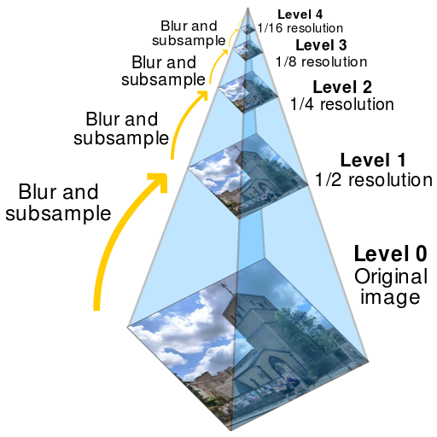
Image pyramid
Image resolution
increases going from
the top to the bottom
of the pyramid
Picture source: https://en.wikipedia.org/wiki/Pyramid_%28image_processing%29

Slide 8
Coarse-to-fine optical flow estimation
u=1.25 pixels
u=2.5 pixels
u=5 pixels
u=10 pixels
image I_{t}
image I_{t-1}
image I_{t+1}
image I
Gaussian pyramid of image I_{t}
Gaussian pyramid of image I_{t+1}

Slide 9
Coarse-to-fine optical flow estimation
OF computation
warp & upsample
OF computation
.
.
.
image J
image I_{t}
image I
image I_{t+1}
Gaussian pyramid of image I_{t}
Gaussian pyramid of image I_{t+1}

Slide 10
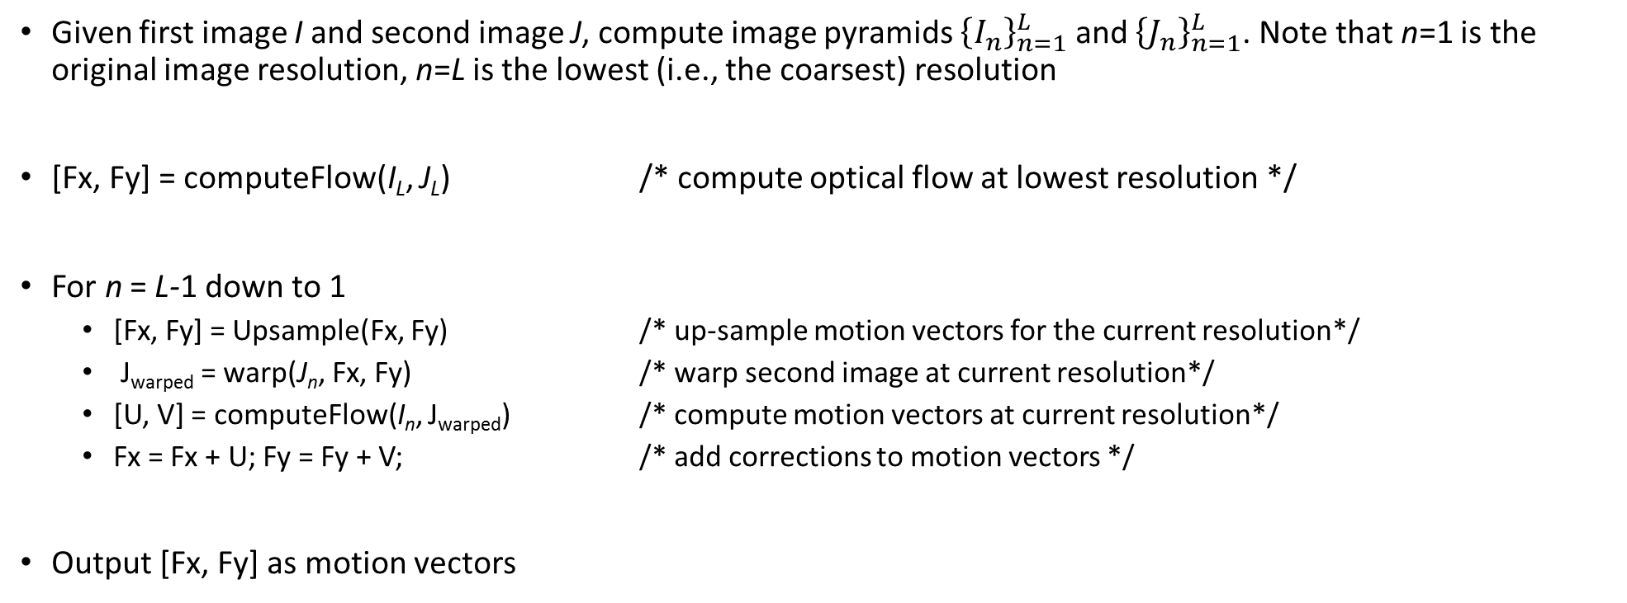
Multi-resolution algorithm for dense optical flow computation
Given first image I and second image J, compute image pyramids ${\left\{I_{n}\right\}}_{n=1}^{L}$ and ${\left\{J_{n}\right\}}_{n=1}^{L}$. Note that n=1 is the original image resolution, n=L is the lowest (i.e., the coarsest) resolution
[Fx, Fy] = computeFlow(I_{L}, J_{L}) /* compute optical flow at lowest resolution */
For n = L-1 down to 1
[Fx, Fy] = Upsample(Fx, Fy) /* up-sample motion vectors for the current resolution*/
J_{warped} = warp(J_{n}, Fx, Fy) /* warp second image at current resolution*/
[U, V] = computeFlow(I_{n}, J_{warped}) /* compute motion vectors at current resolution*/
Fx = Fx + U; Fy = Fy + V; /* add corrections to motion vectors */
Output [Fx, Fy] as motion vectors

Slide 11
Up-sampling motion vector
Increasing motion vector matrix size by interpolating (i.e., inserting) vectors
Then multiply motion vectors by the up-sampling factor
Up-sample
In this example
up-sampling
factor is 1.25

Slide 12
Image Warp
Image and motion vectors
Warped Image
3 | 2 | 0 | 1
4 | 5 | 7 | 3
2 | 1 | 0 | 4
5 | 8 | 9 | 0
4 | 7 | 1 | 1
2 | 7 | 3 | 3
1 | 0 | 9 | 0
5 | 9 | 0 | 0
Warping
We extended border by nearest pixels when needed (when a motion vector lands outside of image border)
We need to do interpolation when a motion vector does not give us integer coordinates

Slide 13
Image warp: example
Warp by
=
Image
Motion vectors
Warped image

Slide 14
Next lecture
We will use optical flow for object tracking

